Slide 1
ONLINE BUS BOOKING SYSTEM
VB Group 8

Slide 2
TEAM MEMBERS
EMPLOYEE ID | NAME
2501758 | Koreboina Esther Rani
2502956 | Tamasjit Ghoshal
2502861 | Venati Jaswanth
2503035 | Pamuri Rajeshbabu
2501849 | C Pinku
2502951 | GV Siva Kumar M
2503083 | Mandapati Jayadeep Raju
2502316 | Manimaran G
2503088 | Chaboksavar Shaik Mohammed Afroz
2502584 | Lokesh PR
2502893 | Embar Balaji Abhinand

Slide 3
INDEX
Introduction
Scope
Modules
Technologies Used
Diagrams
Angular
SpringBoot
Screenshots
Advantages
Features
Conclusion

Slide 4
INTRODUCTION
Our Online Bus Booking System is a Java Spring Boot, MySQL and Angular project that runs on tomcat server.
The purpose of this project is to automate the Bus Booking System process.
Hence, we have designed a web-based application which is hosted on AWS that allows passengers to check ticket availability, book a bus ticket, and pay for it online.

Slide 5
SCOPE
The scope of our project are as follows:
A person should be able to
Login to the system with ID and Password
Book the bus ticket
Choose preferred seat
Make payment

Slide 6
MODULES
1. User Module : User Module has profile, Bookings, Wallet, Change Password and Sign out.
2. Admin Module : Our Admin Module has important functionalities like Bookings, Add Bus, View Buses, Update Route, Preferred Bus and Sign out.

Slide 7
Technologies Used
Frontend | Backend | Deployment
Angular 11 | Spring Data JPA | AWS Elastic Beanstalk
Node js and Npm | Maven | AWS S3
Angular CLI | JDK 1.8 | AWS RDS
TypeScript | Embedded Tomcat Server
Bootstrap | MySQL Database
 | SpringBoot

Slide 8
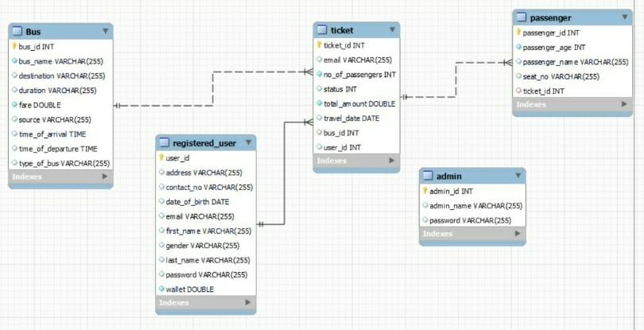
ER diagram

Slide 9
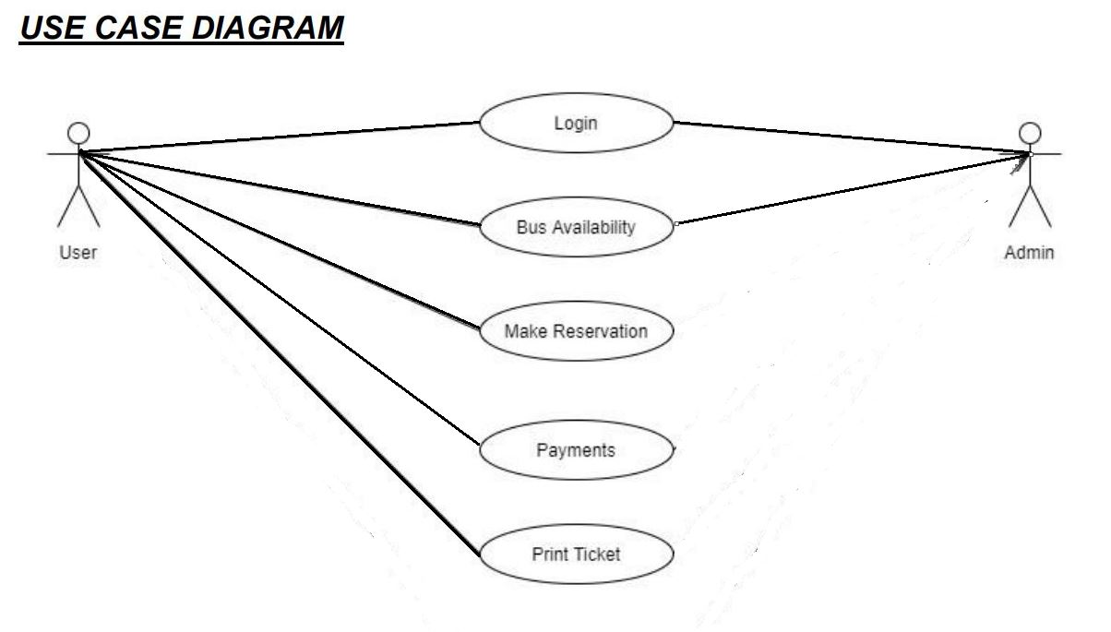
Use case diagram

Slide 10
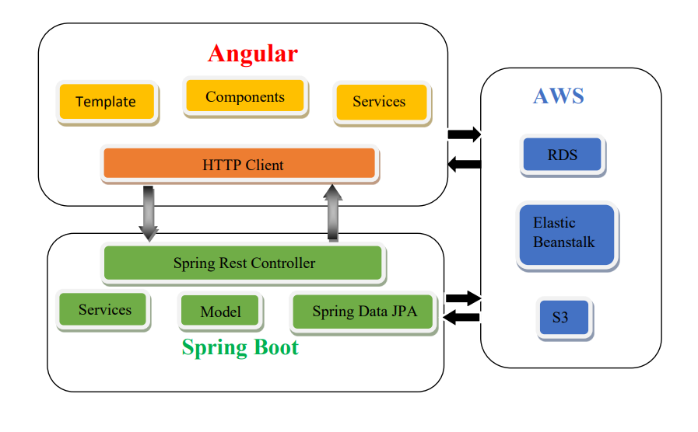
Block diagram

Slide 11
angular
Angular is a platform for building single page client application using HTML and TypeScript.
It is best suited for single page applications.
Angular is modular.
It has certain built-in features like Dependency Injection and Data Binding.

Slide 12
Spring boot
Spring Boot is an open source Java Based framework used to create a microservice.
It helps to create Stand alone and production ready Spring applications.
Spring Boot contains comprehensive infrastructure support for developing a microservice and enables you to develop enterprise ready applications.

Slide 13
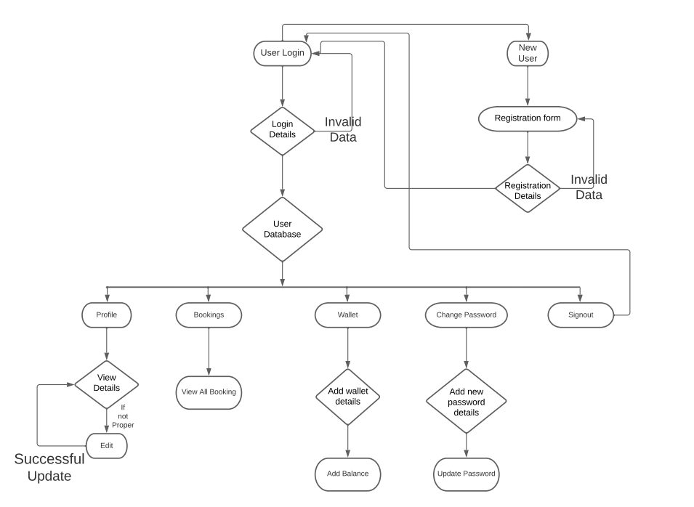
Workflow diagram for user login

Slide 14
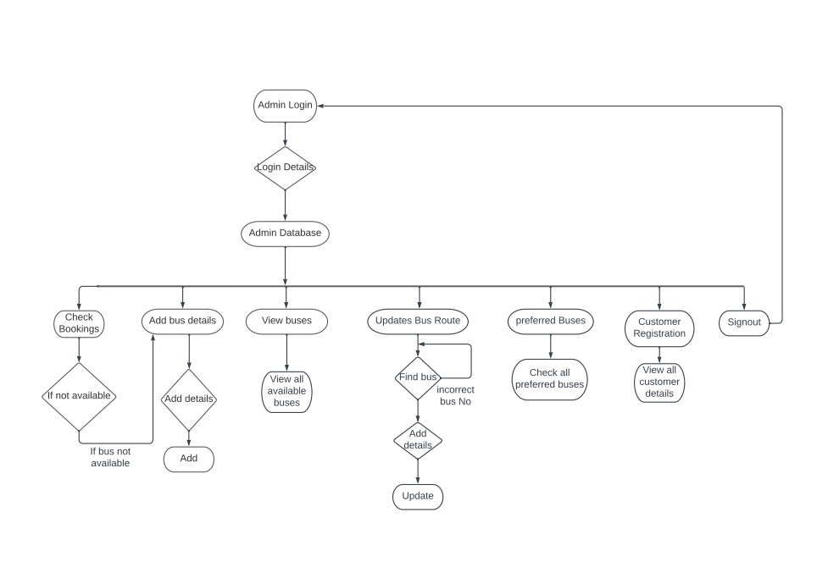
Workflow diagram for admin login

Slide 15
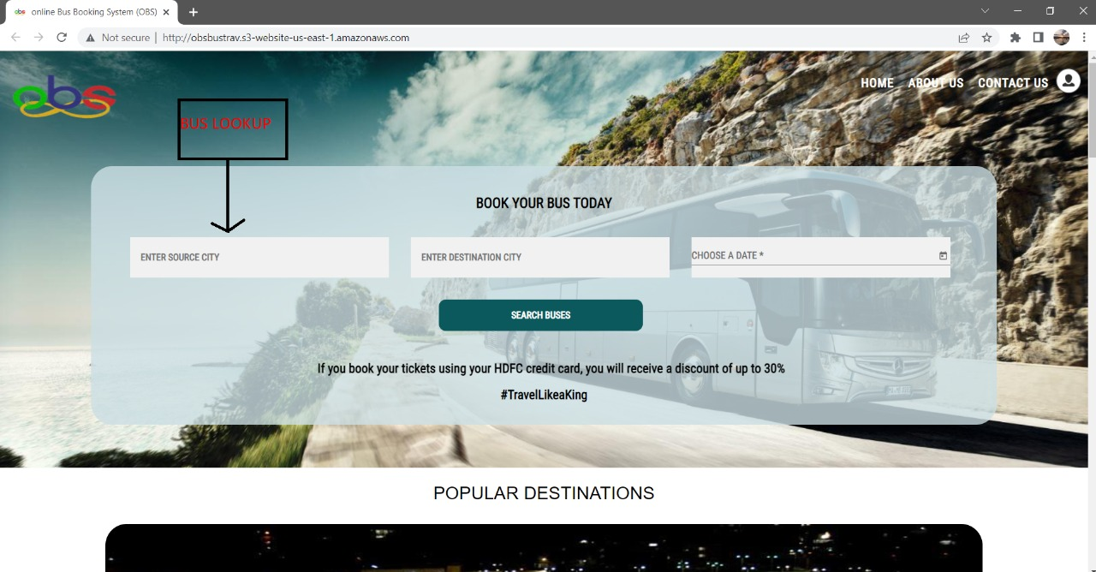
Screenshots

Slide 16
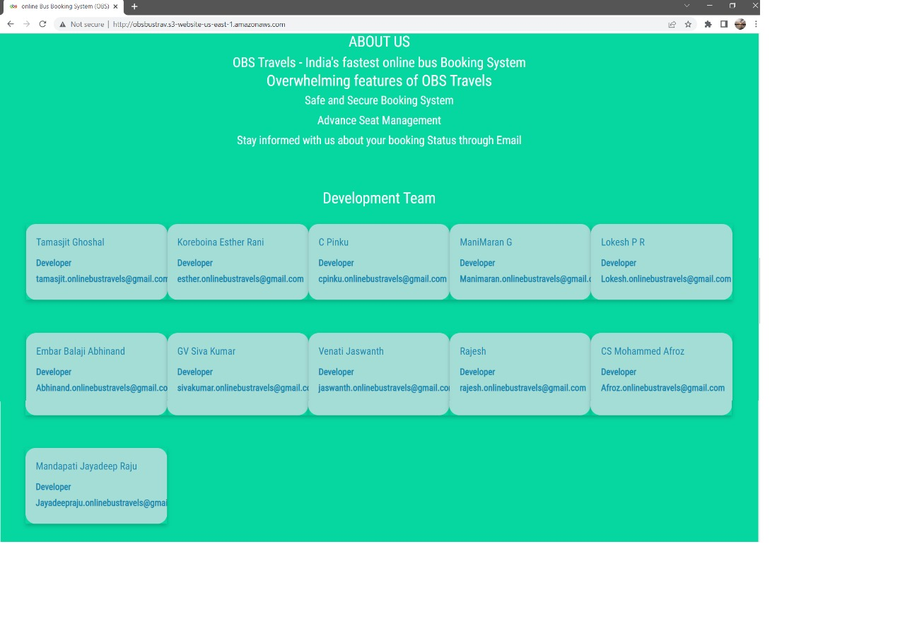

Slide 17
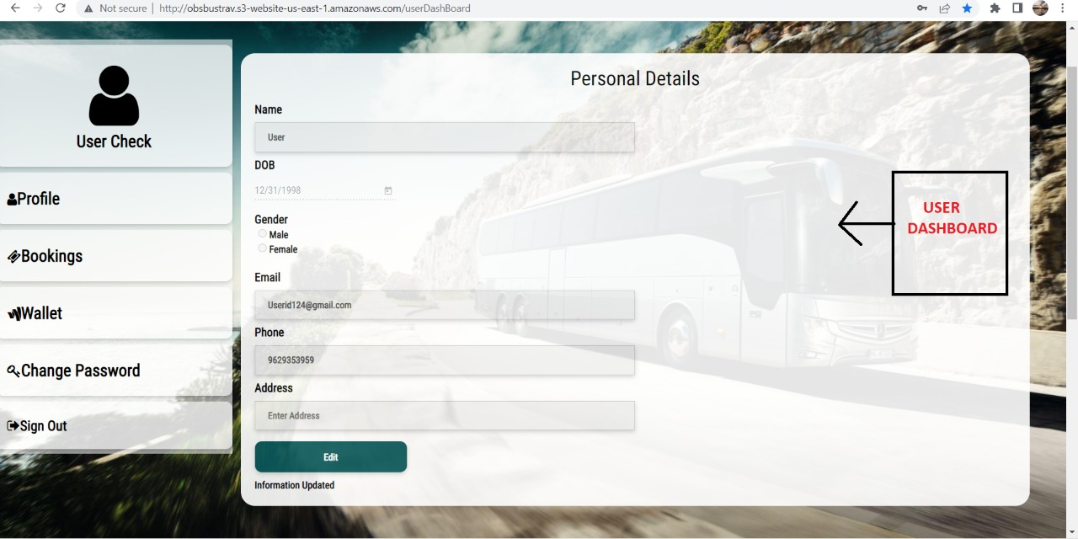

Slide 18
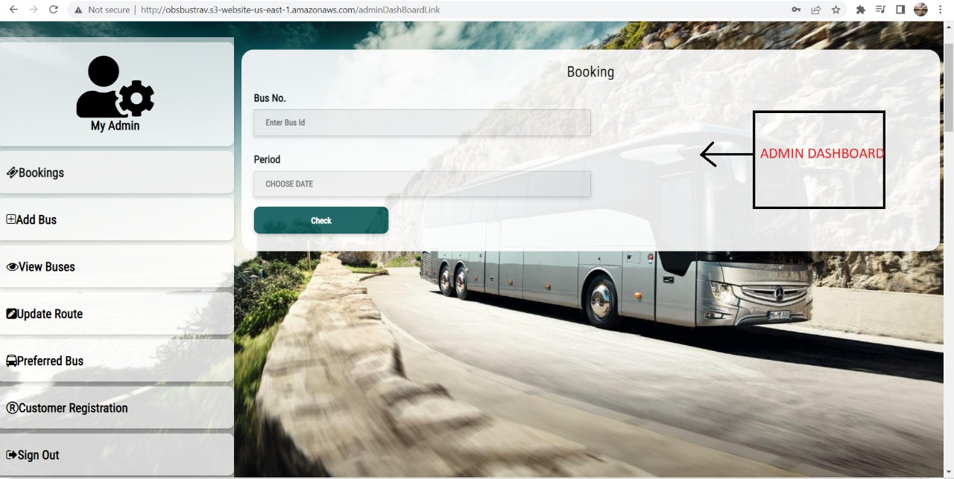

Slide 19
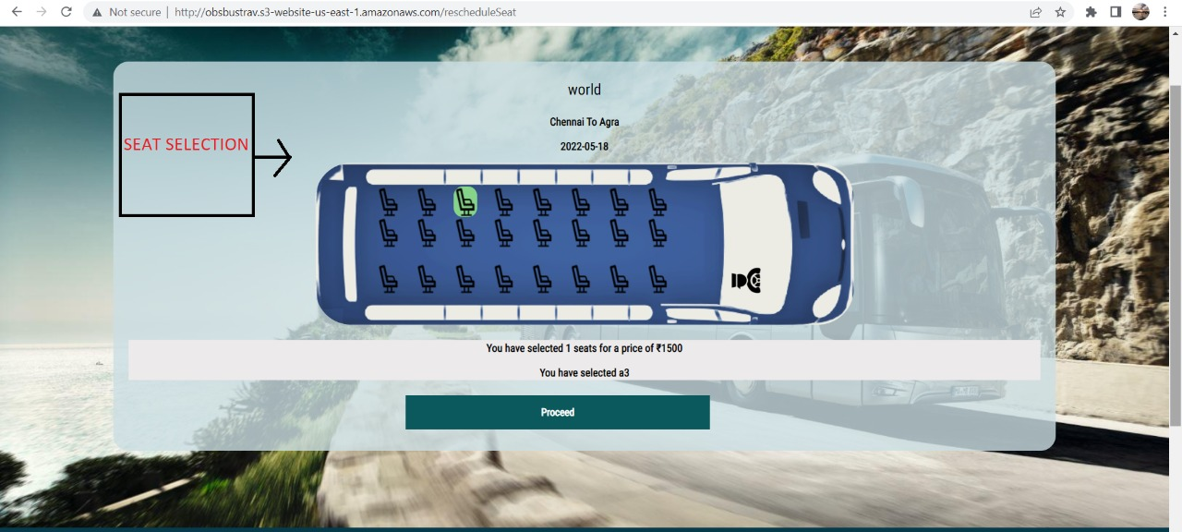

Slide 20
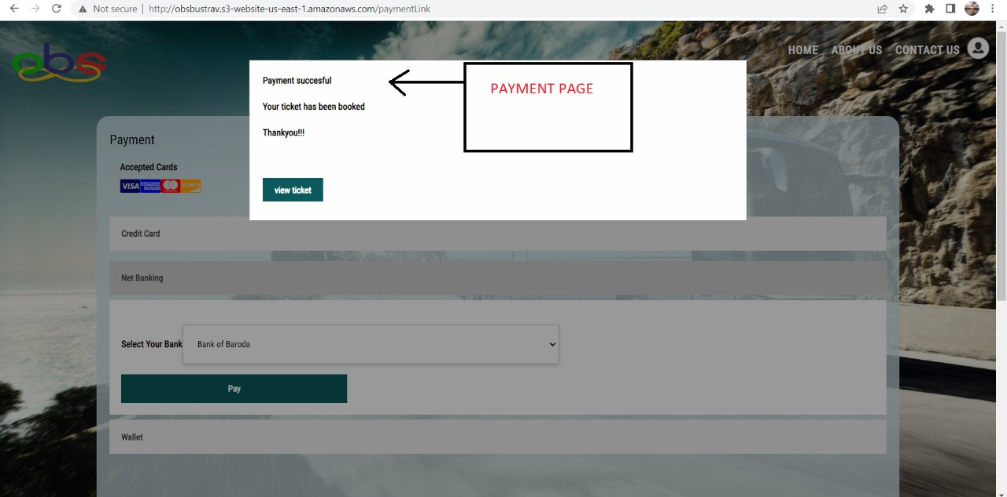

Slide 21
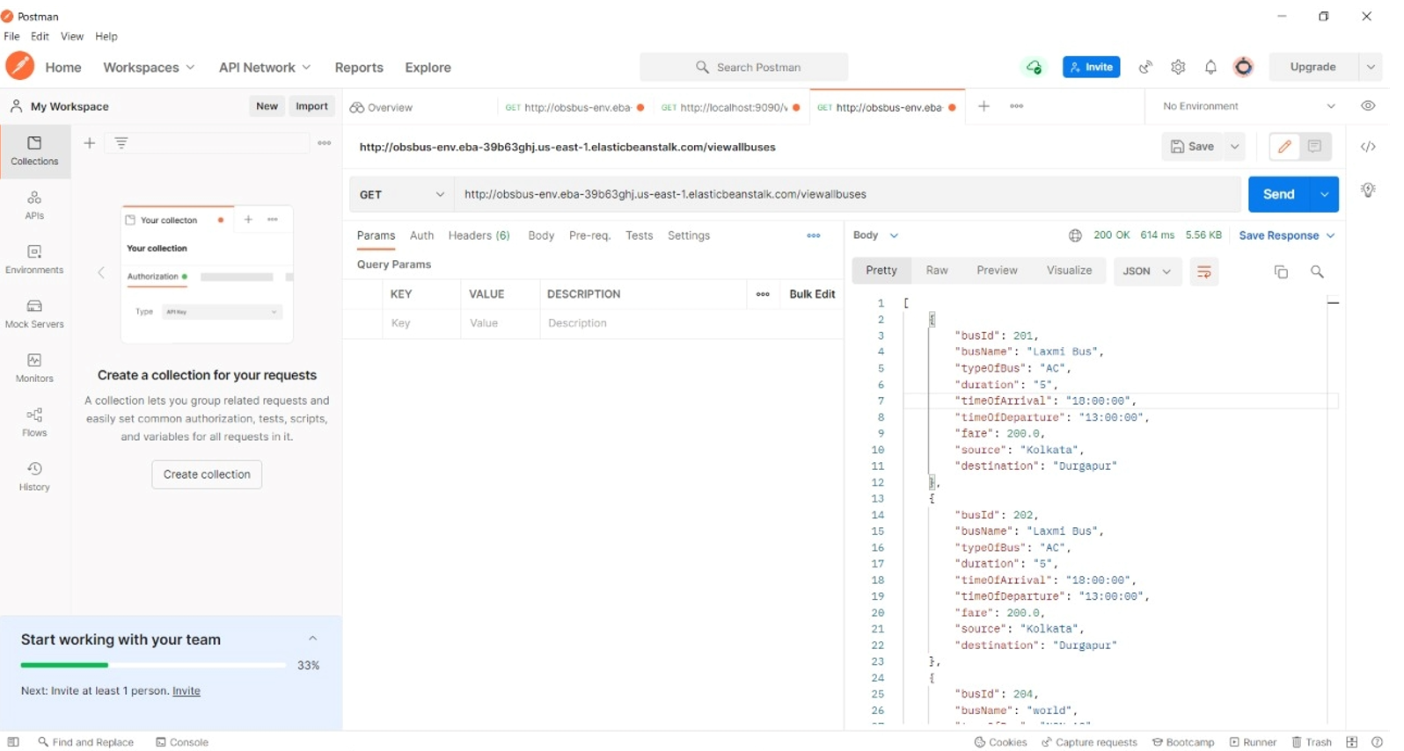
Postman checking

Slide 22
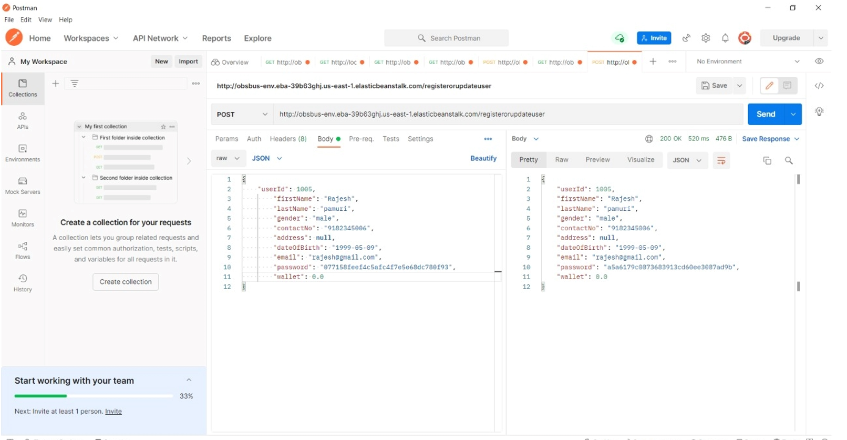

Slide 23
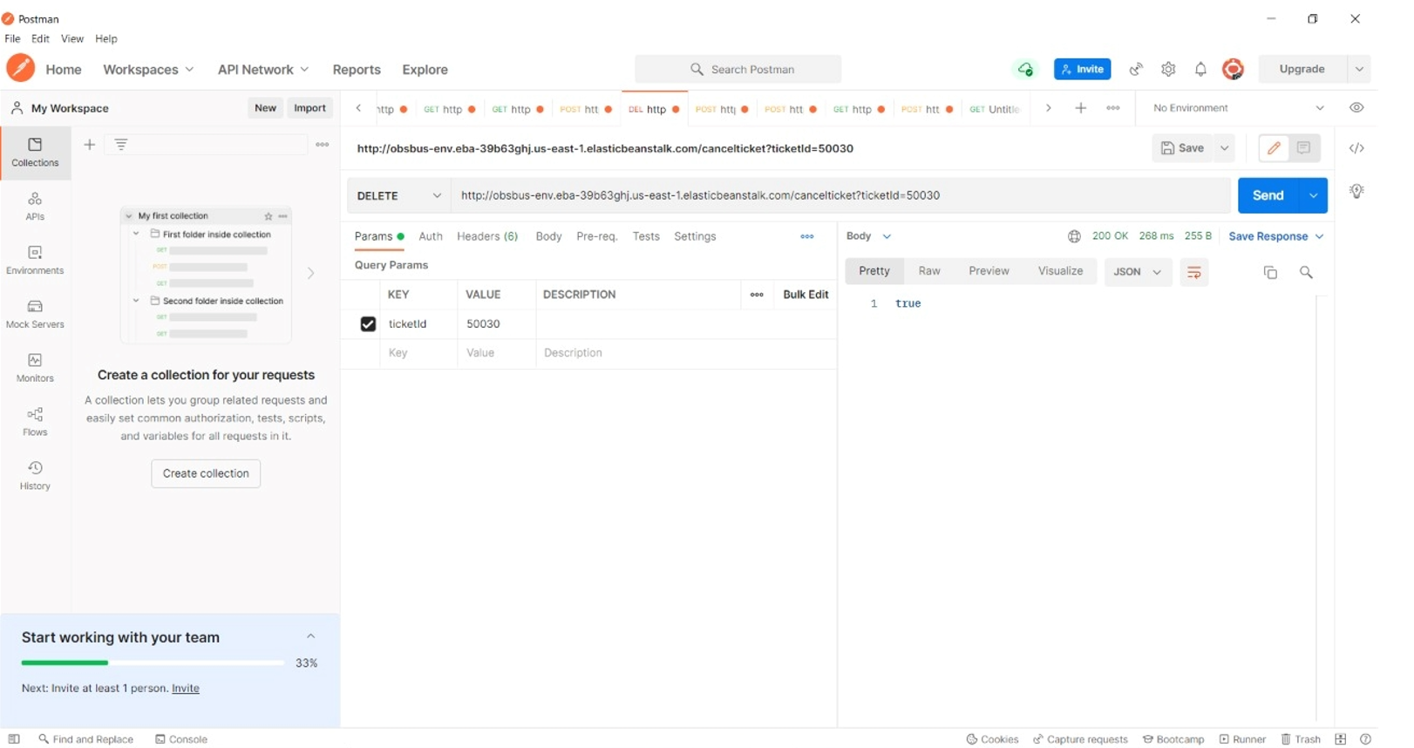

Slide 24
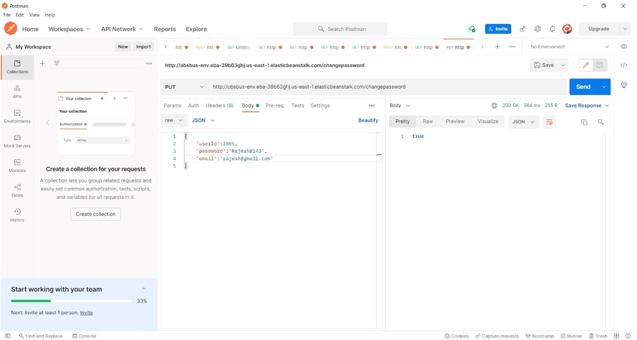

Slide 25
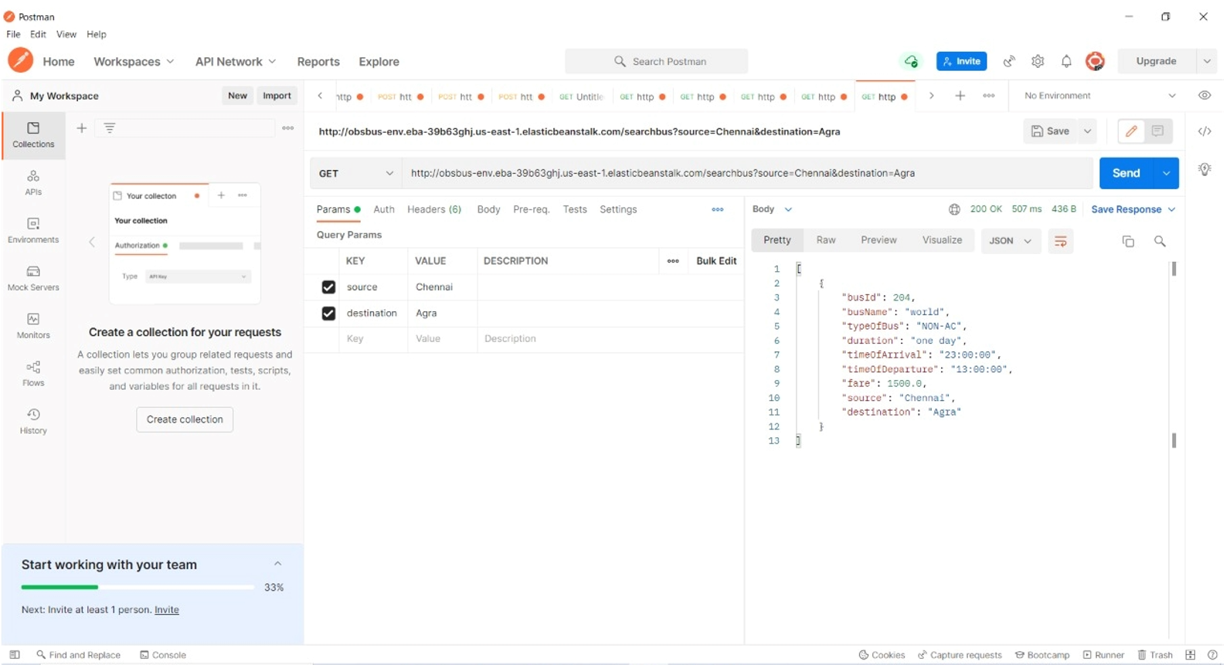

Slide 26
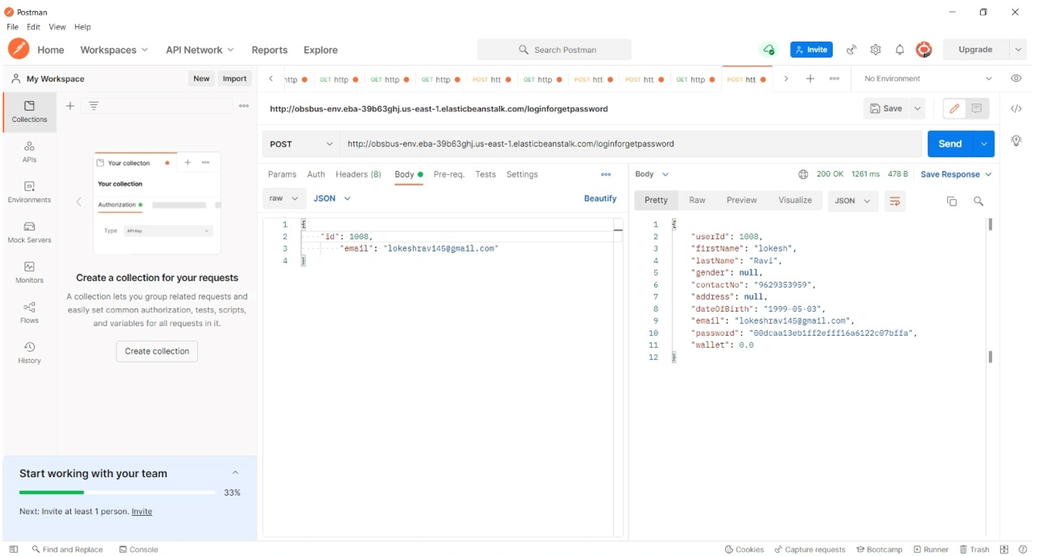

Slide 27
Advantages
User Friendly Interface
Reduced Expenses
Enhanced Customer Experience
24/7 Support

Slide 28
Features
Automation of the entire process
Custom Seat Selection
Efficiency
Time Saving
PDF ticket
Check ticket availability, bus timings and ticket price online
View boarding and dropping point
Access to payment partner’s discount and cashback offers

Slide 29
FUTURE SCOPE
Improvising payment gateway
CI/CD Pipeline for deployment
Sending PDF ticket to mail
Onboarding Reminder
Analytics of User
Login for Travel Agencies

Slide 30
Conclusion
The Online Bus Booking System that we developed, provides passengers an effective method to book their bus tickets, from the luxury of their homes.
This hassle free approach enhances customer satisfaction.
Tickets can be booked from any corner of the globe, which makes our ticket booking process highly flexible.
Custom seat selection allows passengers to choose the location of their seats based on their preference.
The Online Bus Booking System leads to reduction in manual labour which results in reduction in costs.

Slide 31
THANK YOU

